Slide 1


a
Cardiovascular Disease Prediction Using Deep Learning Techniques
Team Members
Aditya Patel (22BM004)
Mohammed Nakib Ansari (22CS089)
Rakesh Yadav (22CS130)
Batch No. : 174
Supervisor :
Ms. NANDHINI N
(Associate Professor)

Slide 2
PROJECT OVERVIEW
1. The Problem:
Manual interpretation of 12-lead ECGs is time-consuming, prone to human error, and often ignores critical demographic context like age and sex.
2. Our Objective:
To develop a Hybrid Deep Learning framework that integrates raw ECG signals with demographic data for accurate, multi-label disease detection.
3. How It Works (The Website):
The system utilizes a dual-branch neural network to fuse physiological waveform features with clinical patient data to simultaneously predict five cardiac conditions.
4. Technology:
Utilizes 1D-Convolutional Neural Networks (1D-CNN) for signal processing, Python libraries for analysis, and Streamlit for real-time web deployment.
5. Why This Matters:
It functions as a clinically aligned diagnostic aid that prioritizes high-risk cases (like Heart Attacks), ensuring timely intervention and reducing diagnostic variability.

Slide 3
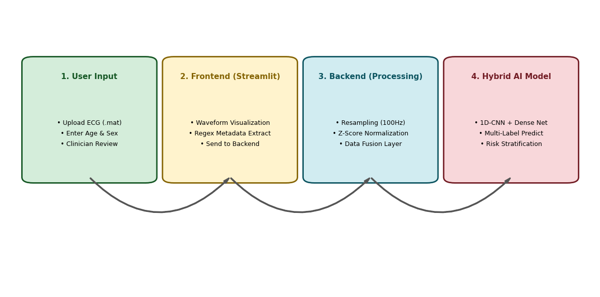
SYSTEM DESIGN

Slide 4
IMPLEMENTATION
1. Primary Language:
Python: The core programming language used for data processing and deep learning.
2. Model Building:
TensorFlow/Keras powered the Hybrid 1D-CNN model training, while WFDB handled raw ECG file parsing. NumPy and Pandas managed signal processing and clinical data, and Scikitlearn was used for dataset splitting and key evaluation metrics like F1-score and Precision.
3. Web Application:
Streamlit: The framework used to deploy the model as a user-friendly clinical dashboard.
Matplotlib: Used to generate dynamic visualizations of the 12-lead ECG waveforms.
Regex: Implemented to automatically extract patient Age and Sex from unstructured header files.
4. Development Tools:
Google Colab: Used for leveraging GPU acceleration during model training.

Slide 5
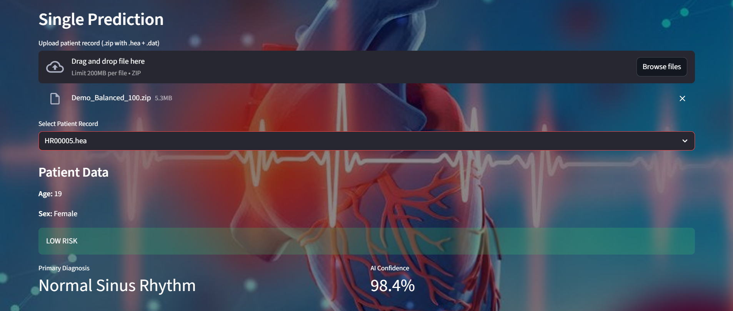
RESULT WITH ANALYSIS

Slide 6
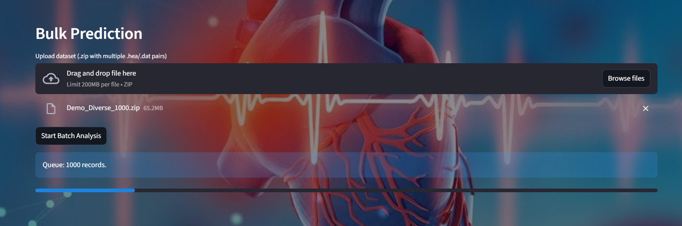
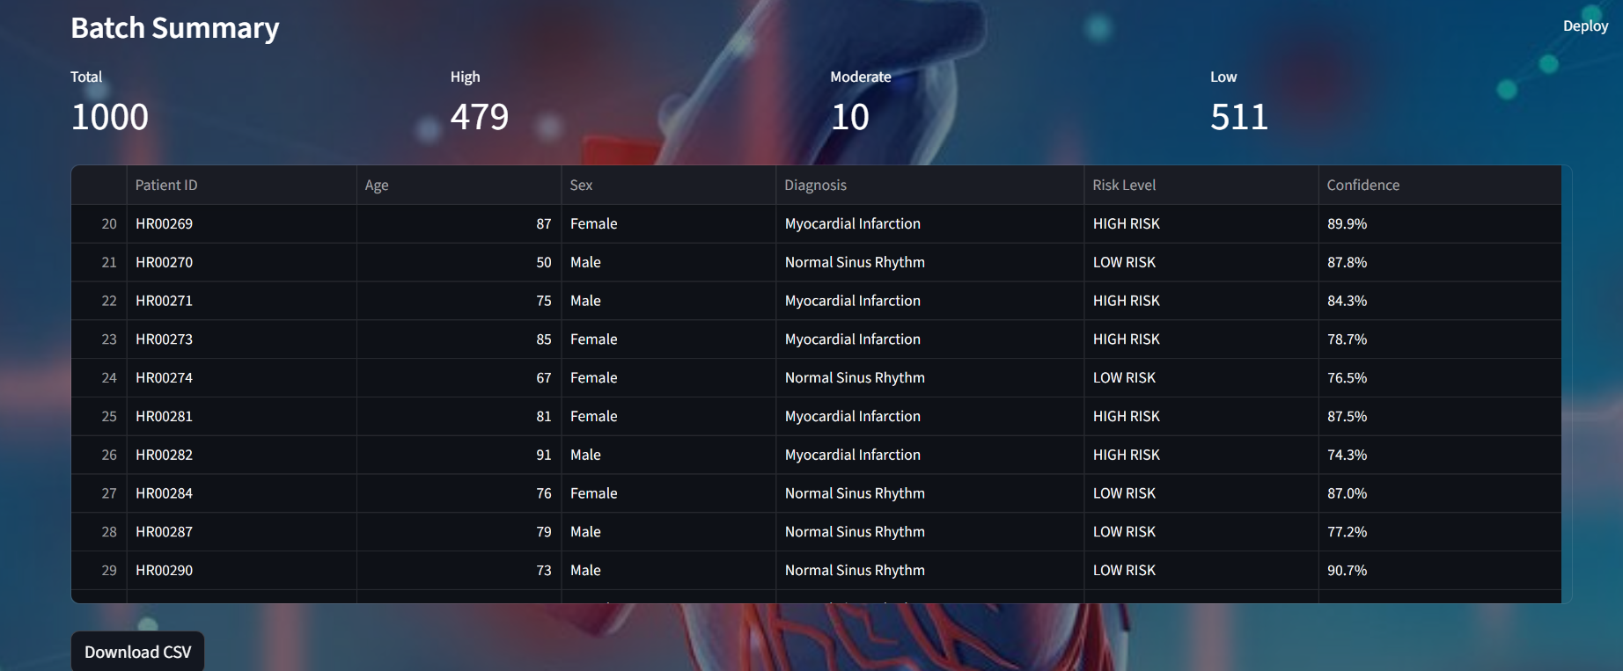

Slide 7
APPLICATIONS
Clinical Decision Support: Acts as an automated "second opinion" for cardiologists to reduce diagnostic errors and fatigue.
Emergency Triage: Instantly flags high-risk cases like Myocardial Infarction (Heart Attack) so doctors can treat critical patients first.
Mass Screening: Uses "Bulk Mode" to process hundreds of hospital ECG records in minutes for efficient preventive health checks.
Rural Healthcare: Provides expert-level ECG analysis to clinics in remote areas where specialized cardiologists are not available.
Tele-Cardiology: Enables general practitioners to upload patient data and get instant, AI-verified risk assessments without sending the patient to a city hospital.

Slide 8



SDG IMPACT
SDG 3: Good Health and Well-being
By providing an accessible tool for early detection, our project helps reduce premature deaths from non-communicable diseases (like heart disease).
SDG 9: Innovation and Infrastructure
We apply an innovative technology (Deep Learning) to solve a major public health problem.
SDG 10: Reduced Inequalities
The web-based tool can be used by anyone, anywhere, helping to bridge the healthcare gap for remote and underserved communities.

